Slide 1
North Quincy High School
An Introduction to the
2020-2021
School Year
Notes:
Rob

Slide 2
Agenda
Meet the administrators and Student Support staff
Remote Learning for Fall 2020
Remote Learning sample schedule
Using Aspen for accessing platform codes (Google Classroom, Zoom etc.)
Chromebook Distribution
Textbook Distribution
Grading policy
Attendance policy
QPS calendar
Student Mental Health and Social Emotional Learning
Athletics, Community Service, and Extracurricular Activities
FAQs
Notes:
Rob

Slide 3
Administration Contact Information
Principal: Mr. Robert Shaw
617-984-8744
Main Office:
617-984-8745
robertshaw@quincypublicschools.com
https://nqhs.quincypublicschools.com
Notes:
Rob

Slide 4
Administration Contact Information
Assistant Principals
Teaching and Learning:
Mrs. Noreen Holland
617-984-8916/857-499-8089
noreenholland@quincypublicschools.com
Operations and Student Support/Dean Class of 2024
Mrs. Helena Skinner
617-371-1166/857-499-8021
helenaskinner@quincypublicschools.com
Notes:
Noreen and Helena

Slide 5
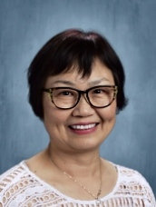
Administration Contact Information
Deans
Class of 2021:
Mr. William Shaughnessy 617-984-8976
williamshaughnessy@quincypublicschools.com
Class of 2022:
Peter Chrisom 617-984-6634
peterchrisom@quincypublicschools.com
Class of 2023:
Mrs. Shaue-Fung Peng 617-984-8977
shauefungpeng@quincypublicschools.com
Notes:
Helena

Slide 6
Student Support Services
Contact Information
Guidance Office tel#: 617-984-8747
Student Support Services Department Head:
Mrs. Rebecca Nutley: 617-984-8985 rebeccanutley@quincypublicschools.com
School Counselors
Mrs. Virginia Cushman: 617-984-8983 virginiacushman@quincypublicschools.com
Mr. Jeffrey DeCristofaro:617-376-1235 jeffreydecristofaro@quincypublicschools.com
Mrs. Mary Devlin: 617-984-8988 marydevlin@quincypublicschools.com
Ms. KeriAnn Hart: 617-984-8988 keriannhart@quincypublicschools.com
Ms. Florence Xia 617-984-8984 florencexia@quincypublicschools.com
Notes:
Becky

Slide 7
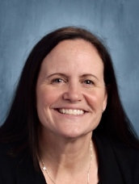
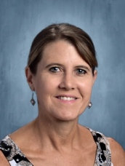
Student Support Dept.
Contact Information
Guidance Office main #: 617-984-8747
PASS Program
Mrs. Francesca Quintero: 617-984-8684 francescaquintero@quincypublicschools.com
Mrs. Melanie Sullivan: 617-984-8685 melaniesulliva@quincypublicschools.com
School Psychologist:
Mrs. Peggy Farren:617-984-8982 peggyfarren@quincypublicschools.com
Health Interventionist:
Mr. Ryan Herlihy: 617-984-8789
ryanherlihy@quincypublicschools.com
Interpreter for Chinese speaking families
Mr. Weijie Luo: 617-984-8976
wiejieluo@quincypublicschools.com
Notes:
Becky

Slide 8
Remote Learning
We, as educators, agree that having your children attend brick and mortar school is the best option for their academic progress and social-emotional success. Until we can meet together again, our teachers are working to make their virtual classes engaging while maintaining the high standards North Quincy High School is known for. We are all looking forward to when it safe!
Notes:
Rob

Slide 9
Remote Learning
We know that it may be difficult for children to stay engaged during Zoom meetings. We have worked hard over the summer to create engaging distance lessons to help your children learn. We encourage students and parents to set up a comfortable area, with limited distractions.
If at any point you see your child struggling to stay on task during meetings, please contact your child’s teacher/counselor and we will work with you to address your concerns
.
Notes:
Rob

Slide 10
Full Remote Schedule details
Students who participate in the Remote Learning model will begin the day at 7:45 and end at 2:30 everyday with a lunch break from 11:20-11:50. Students with 6 classes, during the remote learning term, may also have one “free” study period per day which can be used for a break, independent classwork or for scheduling an appointment with a school counselor or office hours with a teacher if they are free
Students in the “high needs” categories, approved for in-person instruction, will follow a similar schedule; however, they may have differing lunch times and will attend 7 full classes each day
Once a hybrid schedule is available, students will receive a new schedule which may have classes in a different order or possibly with a different teacher
Notes:
Rob

Slide 11
Remote Sample Schedule
Notes:
Rob

Slide 12
First week of school schedule
Wednesday, Sept 16th:
7:45 am Login to homeroom on Google Classroom at this link: https://classroom.google.com/c/MTUzMjEzNTgyNTAz?cjc=ml4qsev .
Homeroom will include attendance and an opening day presentation,
followed by periods B-C-D-Lunch Break-G-E-F (Period A will not meet)
Thursday, Sept 17th:
7:45 am Classes begin in this order: B-A-D-C-Lunch Break- E-F-G
Friday, Sept 18th:
7:45 am/A-B-C-D-Lunch Break-F-G-E
Notes:
Helena

Slide 13
Accessing Online Learning tools
We will continue to use Google Classroom this year. Our hope is that it will help create easy transitions between in-person learning and remote learning.
QPS will utilize Zoom or Google Meets for synchronous (live) remote learning along with Google Classroom for posting assignments, lessons and resources. The Zoom and Google Classroom links for each class will be posted on the student’s profile in Aspen and can be accessed by communicating with Mrs. Holland, Mrs. Skinner or the student’s counselor.
Notes:
Helena

Slide 14
Accessing Platform Codes on Aspen
For remote synchronous learning, teachers can choose Google Meets or Zoom. We will devote most of our time the first week of school to assisting students with becoming familiar with these platforms
Our goal will be to help children learn how to use each of these platforms so they can be more independent during remote learning
You will find additional tutorial links, at the end of the presentation
Notes:
Helena

Slide 15
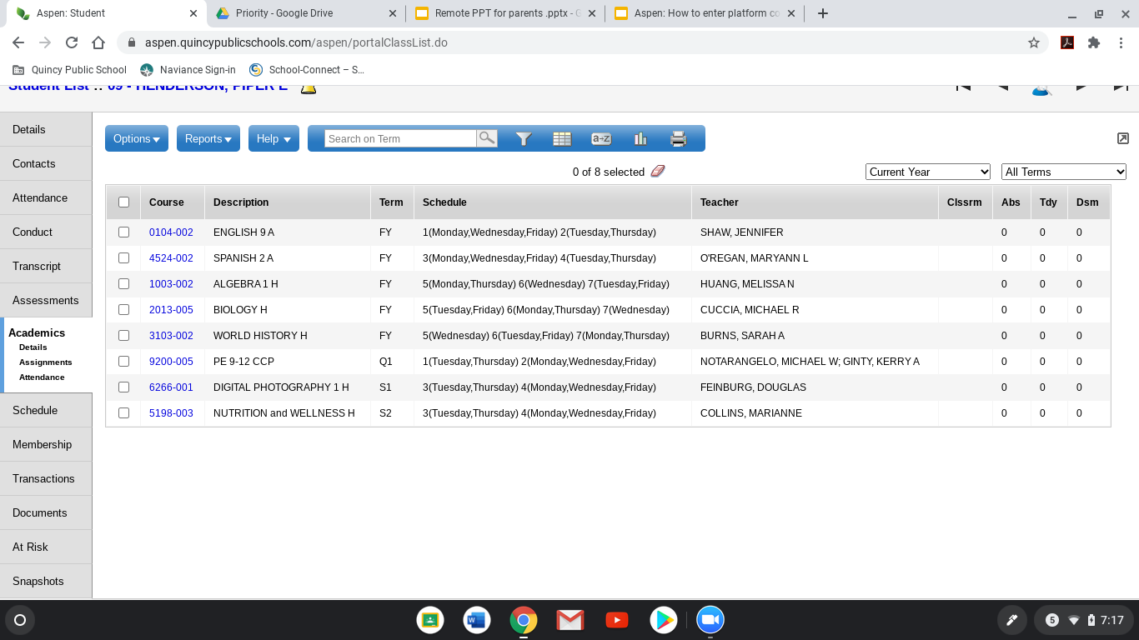
The access the codes will be visible in the Student and family Portal for the Google Classroom, Meets, Zoom or other platforms being used in each class
This feature can be accessed in the Aspen Profile and click on Academics in the side tab then select the class you are trying to check on
Notes:
Helena

Slide 16
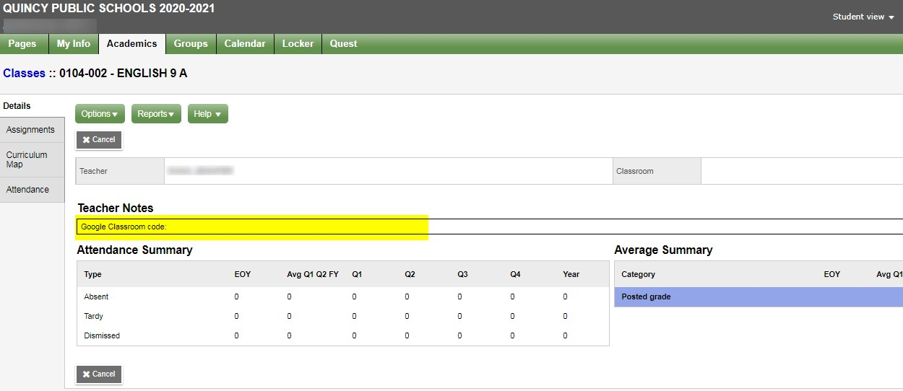
Class codes, links and other important access information will be listed in the “Teacher Notes” box
Notes:
Helena

Slide 17
Homework Policy Update
The School Committee is evaluating the homework policy for this coming school year
The proposed format for homework would allow a set number of classes that could assign homework on Monday-Thursday
Students would not be expected to have homework assigned on Fridays with a Monday due date
Notes:
Noreen

Slide 18
Chromebook Distribution
Quincy Public Schools is planning to roll out a 1:1 Chromebook program this fall. However, due to the global need for Chromebooks we are experiencing shipment delays and will instead start by loaning Chromebooks to students who do not have their own device for remote learning. Once additional Chromebooks become available all students will be issued their own device.
Please follow this link to request a QPS Chromebook for the 2020-21 school year. https://mail.quincypublicschools.com/owa/redir.aspx?C=E_KbFzD1BcFtAWJAtVTJp3x5ycD8dF7bcyJGbN6xyVbRFjeqHUXYCA..&URL=https%3a%2f%2fforms.gle%2fU6zauU6wtQ9MFWFUA
Notes:
Noreen

Slide 19
Textbook Distribution
Students will be issued textbooks for many of their classes. We ask that students select a pick up date/time at the links below via Sign-up.com CDC health guidelines are in effect. Social distancing and wearing a face covering is required.
Students are recommended to bring a bag/backpack to carry home the books.
Book distribution will take place in the Gym on the dates below and students must sign up at the grade specific link:
Grade 9: September 14, 2020 from 9:00-11:30 am-https://signup.com/go/UMqfdsG
Grade 10: September 14. 2020 from 12:00- 2:30 pm-https://signup.com/go/XEqmBbi
Grade 11: September 15, 2020 from 9:00-11:30 am-https://signup.com/go/Wbanpwz
Grade 12: September 15. 2020 from 12:00- 2:30 pm-https://signup.com/go/cxPTVRT
Notes:
Noreen

Slide 20
Grading
Grading will be calculated on a numeric scale from 0-100
63 is the minimum passing grade
0-62 is considered failing
Interim progress reports are tentatively scheduled to be released after Oct 14 on Aspen
Term 1 is tentatively scheduled to end Nov 6 and report cards are tentatively scheduled to be released after Nov 16
Notes:
Noreen

Slide 21
Attendance guidelines
Dismissals for students participating in both remote and in-person instruction will require a note from a parent/guardian to be submitted to the attendance office before 8:00 AM. Parents/guardians may contact the attendance office by email at nqhsattendance@quincypublicschools.com or call 617-984-8746
Notes/emails must include a cell phone number for confirmation.
Parents/guardians are not allowed to dismiss a student from in-person learning without valid photo identification
Notes:
Helena

Slide 22
Updated QPS School Calendar
First day of school is Wednesday, September 16 for grades 9-12 at 7:45 AM
The following are the currently scheduled Release Days for the first term. Dismissal is at 12:40 pm:
Sept. 23
Oct. 14
Notes:
Helena

Slide 23
Student Mental Health and Social Emotional Learning
Our priority is to help children learn and prepare them for a successful future. We know that last spring was a very difficult time for many families and that all students will benefit from a supportive learning environment
Teachers and counselors will spend time providing assistance to students who may need additional support. If at any time you have concerns about your child, please do not hesitate to contact your child’s counselor
Counselors plan on offering support to students through virtual check-ins, office hours/appointments and in classrooms, and google classroom postings. Stay tuned for a monthly Student Support newsletter with information to support families through this remote learning phase
Notes:
Becky

Slide 24
Remote Learning Best Practices
Create a calm environment
Listen and offer time to reflect about the learning process
Enforce good routines - plan a daily schedule
Prepare that things may change
Help student to find a comfortable place to learn with minimal distractions
Ask for help, if needed
Keep a list of teachers contact information and classroom codes
Help your student keep organized - use a planner or calendar for assignments
Reach out to school counselor
Plan time away from computer once the remote learning day is over
Notes:
Becky

Slide 25
Community Service, Extracurricular Activities and Athletics
Athletics: The athletics information session will be held with Mr.JJ Niamkey next week
Community Service: At this time the Quincy school committee has not yet addressed any changes to the community service requirement. Please stay tuned for updates on community service
Extracurricular Activities: Stay tuned for a virtual information session for students and families listing the activities and clubs available and how to join
Notes:
Helena

Slide 26
FAQs
Attendance: Please see slide 19
Community Service requirement: At this time the Quincy school committee has not addressed any changes to the community service requirement
CVTE requirements: The hours required for on-site/lab certification will be delayed until we can return in hybrid or full in-person models
GPA: GPA will be calculated for each term this year
MCAS administrations: At this time the Spring 2021 MCAS in ELA and Math is still being administered to the Classes of 2022 and 2023. The Science MCAS requirement has been modified.

Slide 27
FAQs
Meeting with counselors: Counselors are available for individual meetings and have set up grade level Google Classrooms to provide timely information. Counselors will also be setting up times with teachers to meet with classes within each grade. A senior information session will be available on Sept. 11. (more information to follow)
Physical Education: PE classes will be held in remotely term 1
SAT/ACT administrations: Students expecting to attend college in the Fall of 2021 should register for one of the test administrations at www.collegeboard.org or www.act.org and check their websites frequently for updates
Textbook distribution: Please see slide 17

Slide 28
Tutorials/Resources
Google Apps: https://docs.google.com/spreadsheets/d/1_S9A45vTRArvGC7OUwfCzEwRgNRUypjLNlX9vO8_MOs/htmlview?usp=sharing&pru=AAABdE8ccFo*eLmqFHuZf8l1mxyqQpB6SQ
Zoom tutorial for students:
https://www.youtube.com/watch?v=wbnyQwsVbiY
Remote Learning Best Practices for Parents: http://teachtrainlove.com/virtual-learning-10-best-practices-for-parents/

Slide 29
Thank you for taking time to join us.

